Slide 1
Software Testing and Quality Assurance
Lecture – 20

Slide 2
Static vs Dynamic Anomaly Detection
Static Analysis is analysis done on source code without actually executing it.
E.g., Syntax errors are caught by static
analysis.

Slide 3
Static vs Dynamic Anomaly Detection (Cont’d)
Dynamic Analysis is analysis done as a program is executing and is based on intermediate values that result from the program’s execution.
E.g., A division by 0 error is caught by dynamic
analysis.
If a data-flow anomaly can be detected by static analysis then the anomaly does not concern testing. (Should be handled by the compiler.)

Slide 4
Anomaly Detection Using Compilers
Compilers are able to detect several data-flow anomalies using static analysis.
E.g., By forcing declaration before use, a
compiler can detect anomalies such as:
-u
ku
Optimizing compilers are able to detect some dead variables.

Slide 5
Simple Path Segments
A Simple Path Segment is a path segment in which at most one node is visited twice.
– E.g., (7,4,5,6,7) is simple.
Therefore, a simple path may or may not be
loop-free.

Slide 6
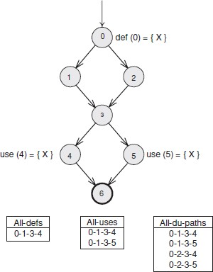
Paths - Explained

Slide 7
Data-Flow Testing Strategies
All du Paths (ADUP)
All Uses (AU)
All p-uses/some c-uses (APU+C)
All c-uses/some p-uses (ACU+P)
All Definitions (AD)
All p-uses (APU)
All c-uses (ACU)

Slide 8
Example

Slide 9
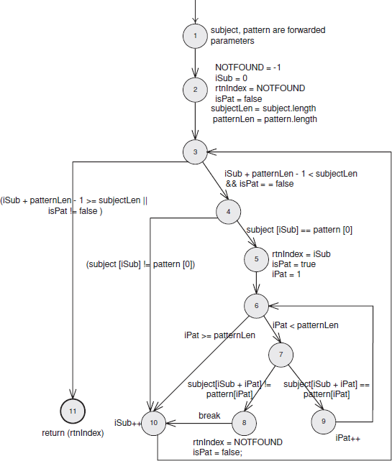

Slide 10
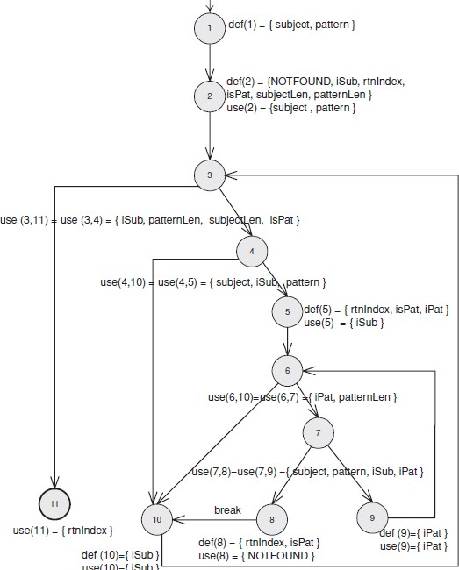

Slide 11
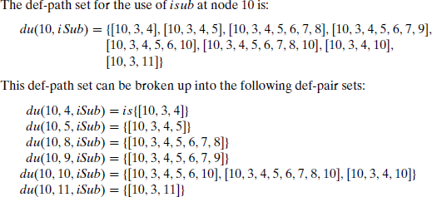
Paths

Slide 12
Relationship among DF criteria
ALL-PATHS
ALL-DU-PATHS
ALL-USES
ALL-P-USES/SOME-C-USES
ALL-C-USES/SOME-P-USES
ALL-P-USES
ALL-C-USES
ALL-DEFS
ALL-EDGES
ALL-NODES

Slide 13
Coverage-based testing of requirements
Requirements may be represented as graphs, where the nodes represent elementary requirements, and the edges represent relations (like yes/no) between requirements.
And next we may apply the earlier coverage criteria to this graph
Discussed in detail by Boris Beizer in his book

Slide 14
Example translation of requirements to
a graph
A user may order new books. He is shown a screen with fields to fill in. Certain fields are mandatory. One field is used to check whether the department’s budget is large enough. If so, the book is ordered and the budget reduced accordingly.
Enter fields
Notify user
All mandatory fields there?
Check budget
Order book
Notify user

Slide 15
Similarity with Use Case success scenario
Enter fields
User fills form
Book info checked
Dept budget checked
Order placed
User is informed
Notify user
All mandatory fields there?
Check budget
Order book
Notify user

Slide 16
Summary
Data are as important as code.
Define what you consider to be a data-flow anomaly.
Data-flow testing strategies span the gap between all paths and branch testing.

